Slide 1
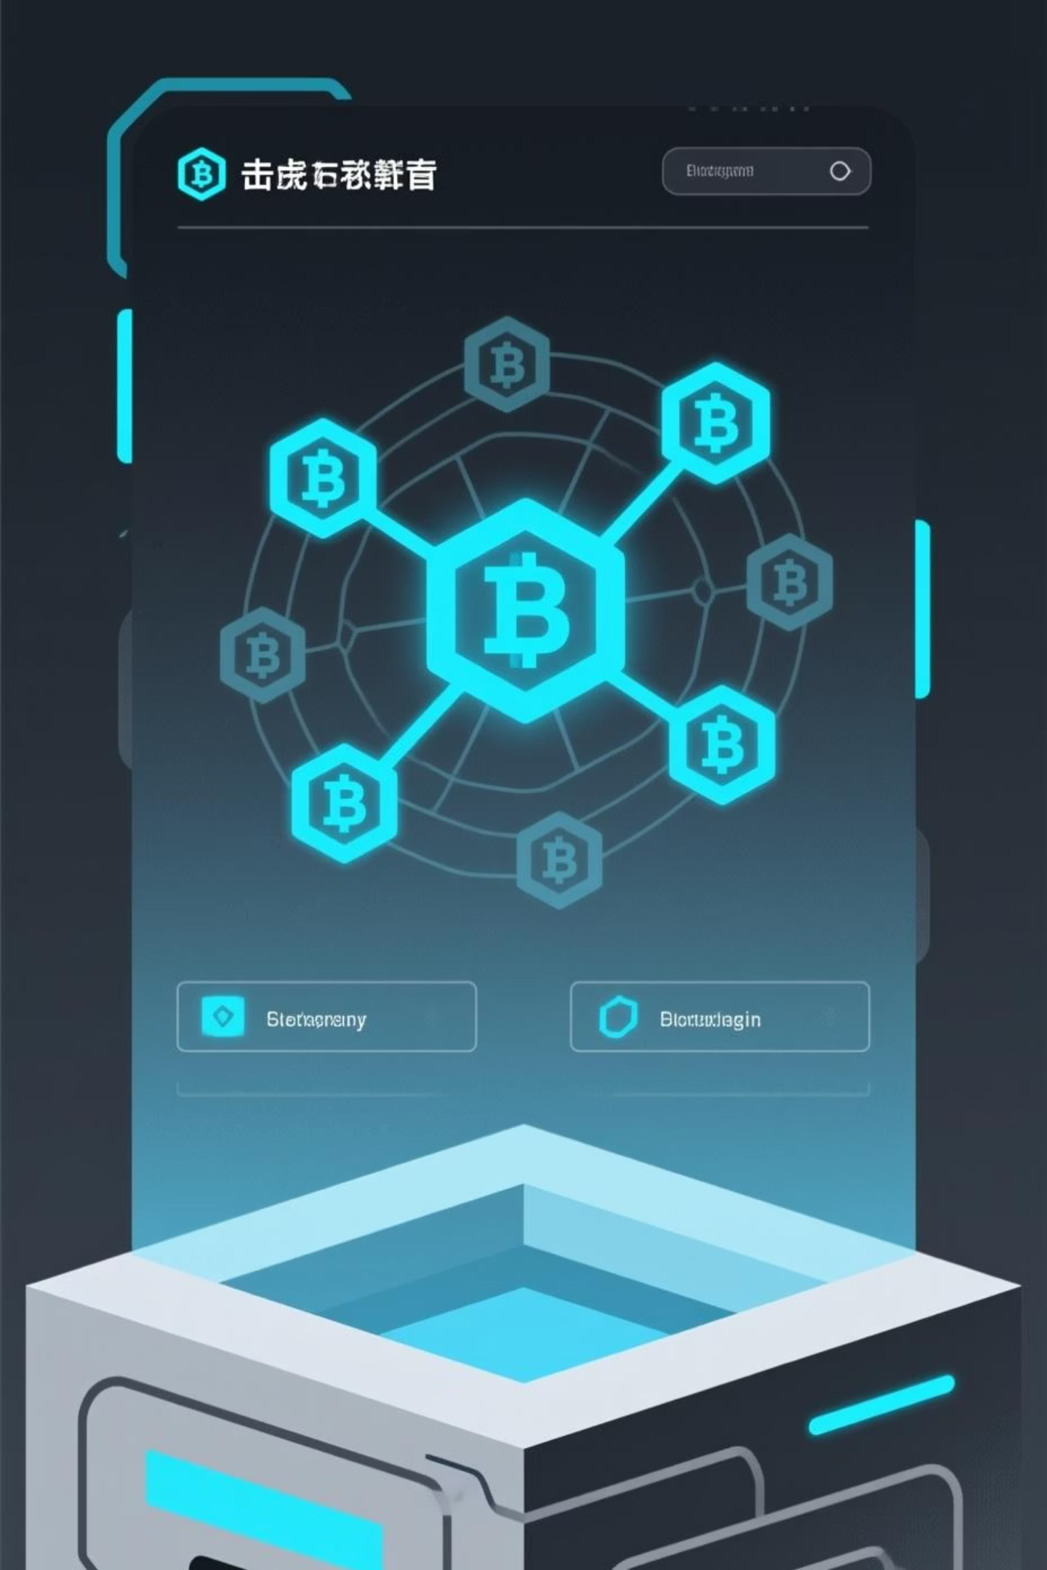
Online Voting System
Secure, transparent, tamper-resistant voting powered by blockchain technology

Slide 2

System Purpose & Scope
Purpose
Scope
Enable secure online voting using blockchain to ensure immutability, transparency, and tamper-resistance for elections and polls.
Voter registration, authentication, election management, vote casting, tallying, and result display. Excludes physical ballots and extensive legal frameworks.

Slide 3








System Architecture & Users
Admin
Voter
Creates elections, manages voter lists, configures system settings.
Registers, authenticates, casts votes in active elections.
System
Auditor
Web application integrated with blockchain backend and database.
Views results and audit logs; ensures transparency and integrity.

Slide 4
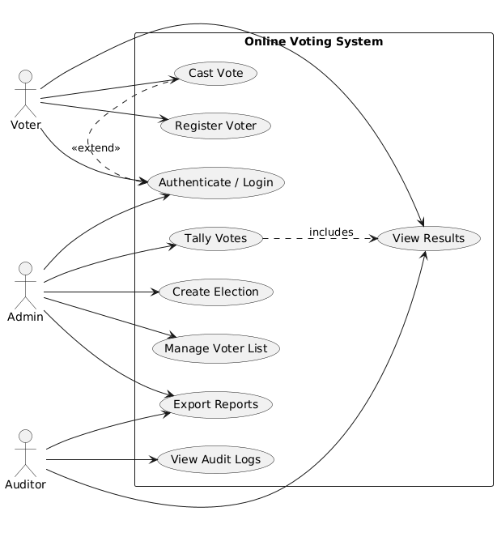
USECASE DIAGRAM

Slide 5
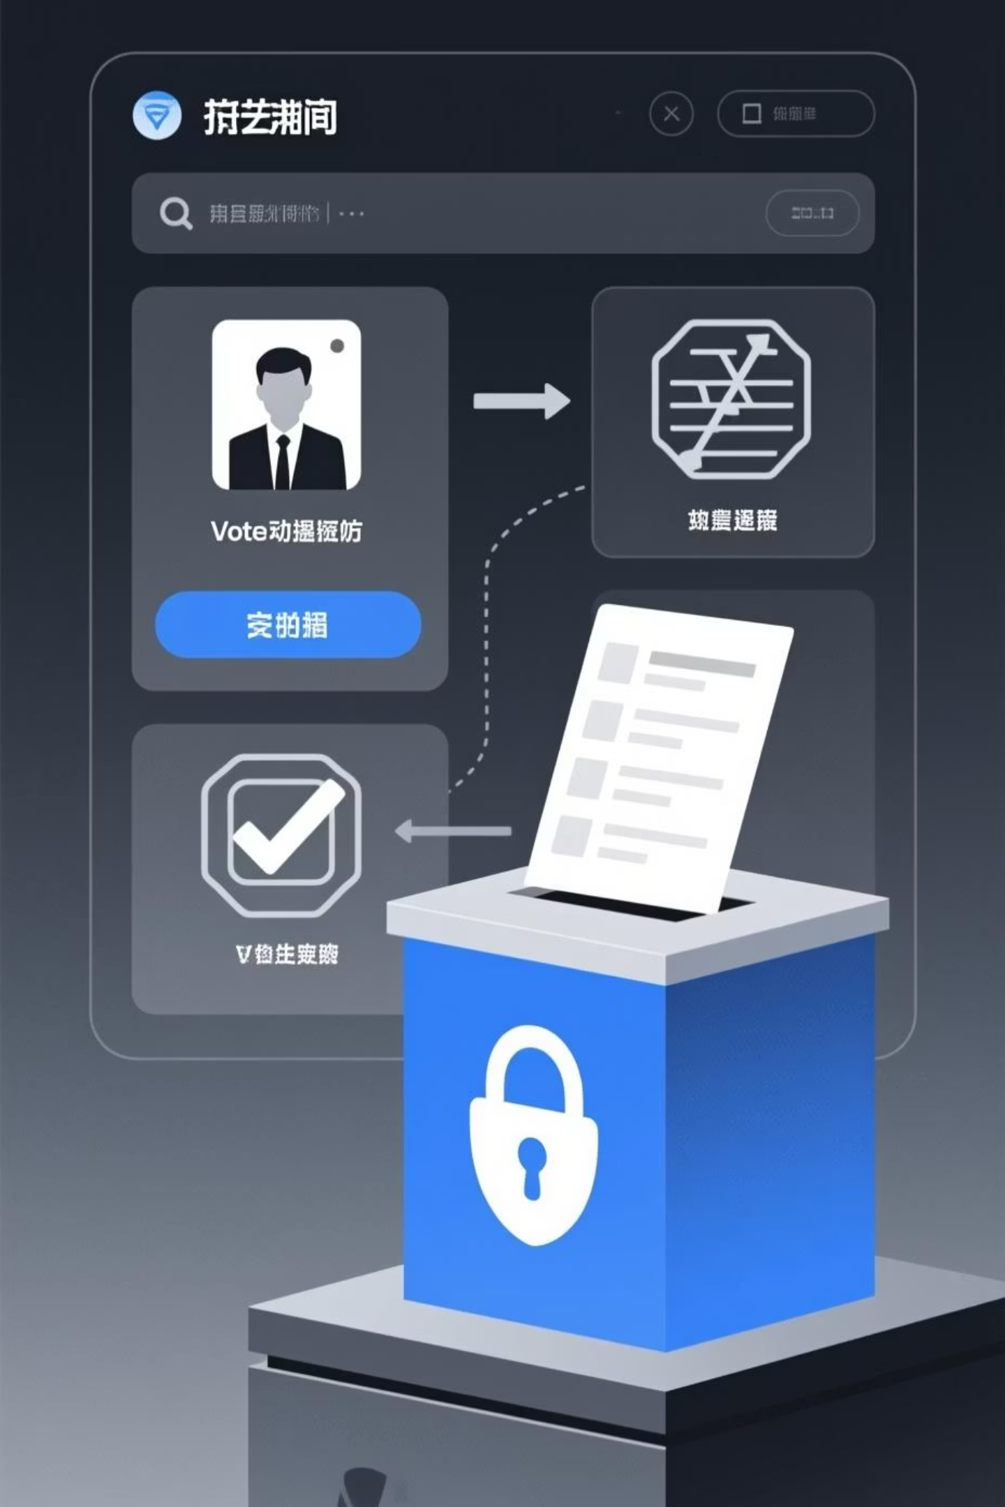
Core Functional Requirements
1
Voter Registration
Users provide identity information; system validates and assigns unique voter ID.
2
Authentication
Registered voters log in with credentials; access restricted to valid election windows.
3
Election Creation
Admins create elections with title, options, start/end times; can modify before start.
4
Vote Casting
Authenticated voters select one option; system records transaction on blockchain with election ID, timestamp, and pseudonymized voter ID.

Slide 6
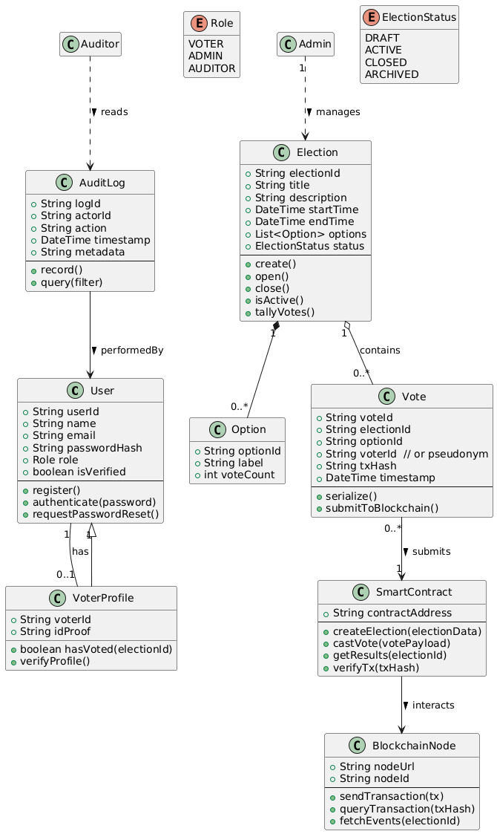
CLASS DIAGRAM

Slide 7
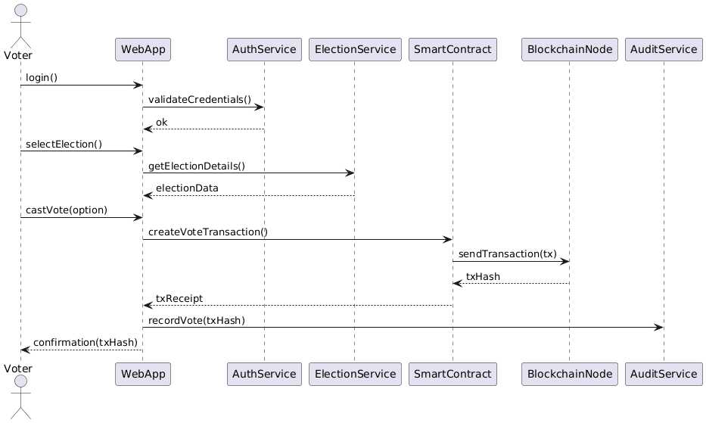
SEQUENCE DIAGRAM

Slide 8
Non-Functional Requirements
5s
99.5%
10K
100%
Performance
Availability
Scalability
Reliability
Vote casting completes within 5 seconds under 100 concurrent users.
System operational throughout election period with minimal downtime.
Supports 10,000 concurrent voters during peak voting periods.
Recorded votes guaranteed immutable; cannot be lost or modified.

Slide 9
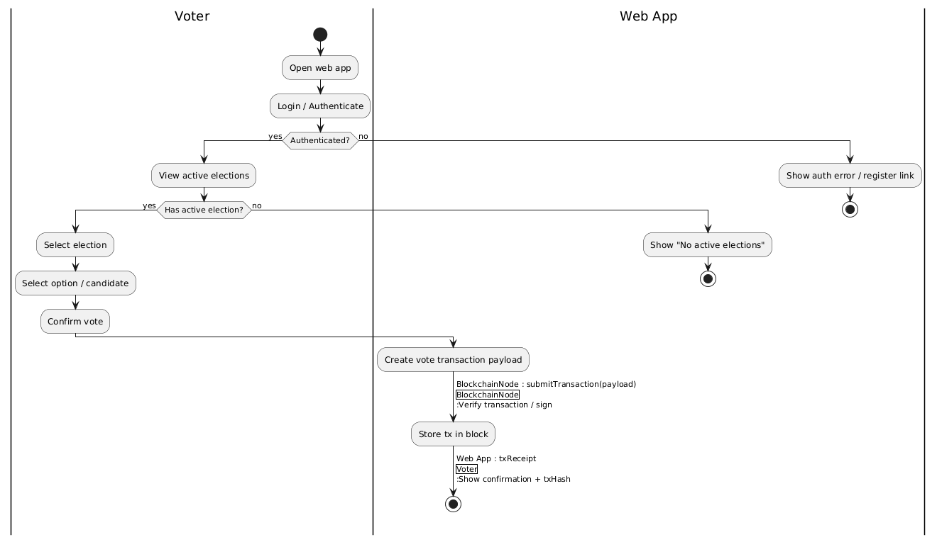
ACTIVITY DIAGRAM

Slide 10

Security & Privacy
Authentication Security
Data Protection
HTTPS/TLS encryption for all communications. Voter identities not publicly linked to votes. Compliance with GDPR and data protection regulations.
Passwords hashed using bcrypt. Two-factor authentication supported. Role-based access control for admin, voter, auditor roles.
Vulnerability Prevention
Protection against XSS, CSRF, SQL injection. Secure blockchain node credentials. Regular backups with recovery within 30 minutes.

Slide 11
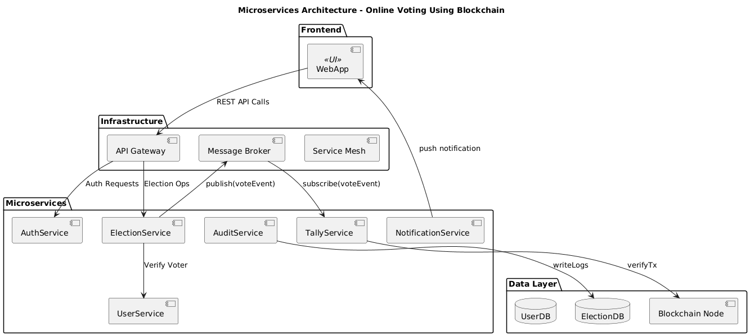
MICROSERVICES DIAGRAM

Slide 12
System Features & Interfaces
01
02
Election Setup
Voting Module
Admin configures election details, options, and timeline through web interface.
Voter logs in, views active elections, casts vote, receives confirmation.
03
04
Result Module
Audit & Transparency
System tallies votes from blockchain ledger and displays transparent results.
Ledger viewer shows transactions; audit logs track admin actions while preserving voter anonymity.

Slide 13




Implementation & Compliance
Technical Stack
Web frameworks, database for user data, blockchain nodes, email service integration.
Compliance
GDPR compliance, WCAG accessibility standards, jurisdiction-specific election guidelines.
Maintenance
Modular design enables future upgrades. Comprehensive documentation and user training provided.

Slide 14
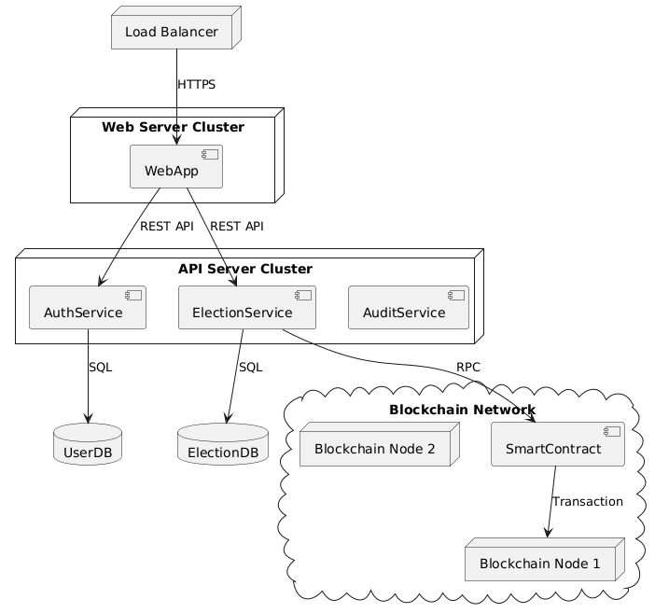
DEPLOYMENT DIAGRAM

Slide 15
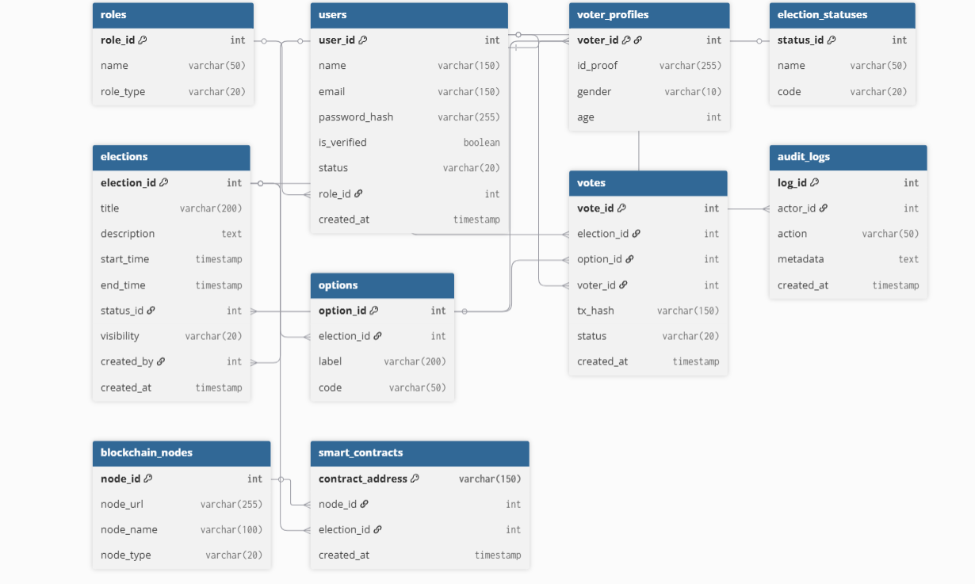
DATABASE SCHEMA DESIGN

